Slide 1

Energy Security and Reliability- AEMR
Marie Vrablic-Data Analyst

Slide 2
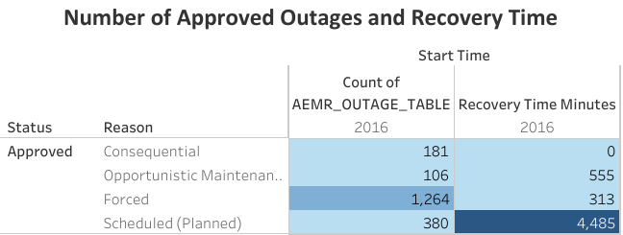
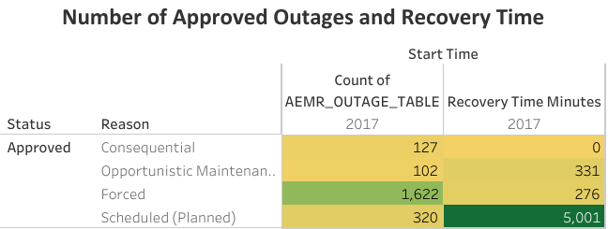
In 2016 and 2017, forced outages occurred the most (1,264 and 1,622 times respectively). Although most of the recovery time occurred with planned outages, the number of forced outages is near 30% higher, suggesting unreliable energy providers.

Slide 3
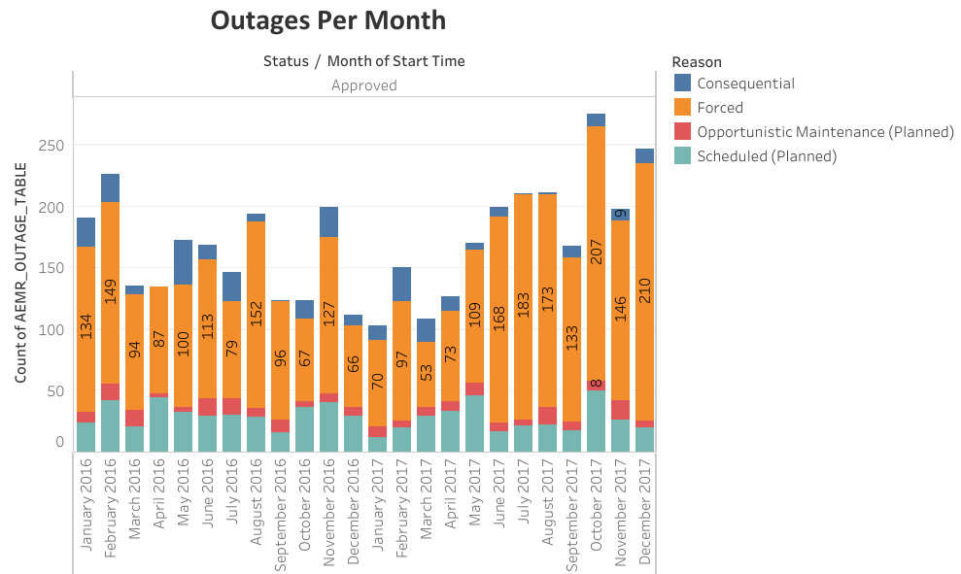
The maximum number of outages occurred in October of 2017 (207 outages) and December 2017 (210 outages).
Notes:
Forced outages are shown in orange, clearly marking how most outages are occurring per month.

Slide 4
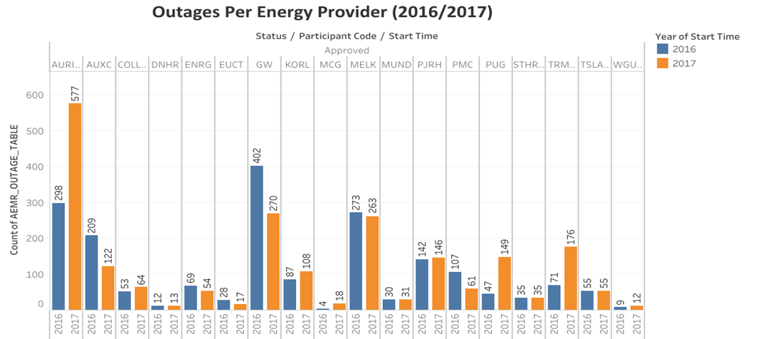
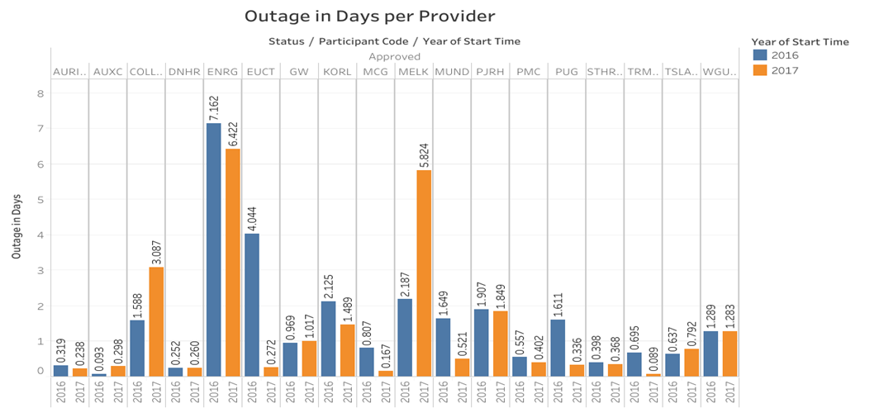
Auricon has the highest number of outages, increasing by 93.6% from 2016 to 2017. Although ENRG had a combined total of 13.5 days in outages, it had one of the lowest total outages of 123, also decreasing from 2016 to 2017. GW had the second greatest number of outages at 672, but that total decreased from 2016 to 2017 by 32.8%. It's outages only equates to 2 days over the two-year period. Melk had a moderate number of outages with 536 and 8 days over the 2016-2017 period.
Notes:
Although you can see from the bottom graph that ENRG had the highest number of days with outages, we can assume that it may have been caused by a storm or something that occurred within one time period, given the low total of outages over the 2 years being low.
GW may be a provider we want to keep an eye, but given it's decrease in number of outages and days of outages over 2016 and 2017, it may not be a concern at this time.
MELK may be a provider we want to look more into because although the number of outages decreased slightly over the 2 year period, the number of days of outages increased by more than 300% from 2016-2017.

Slide 5
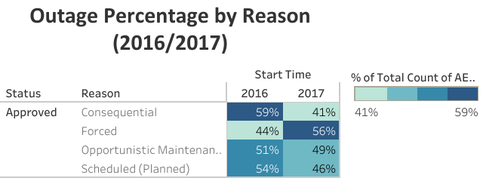
Forced outages have increased by 12% from 2016 to 2017. It is the only type of outage that increased.

Slide 6
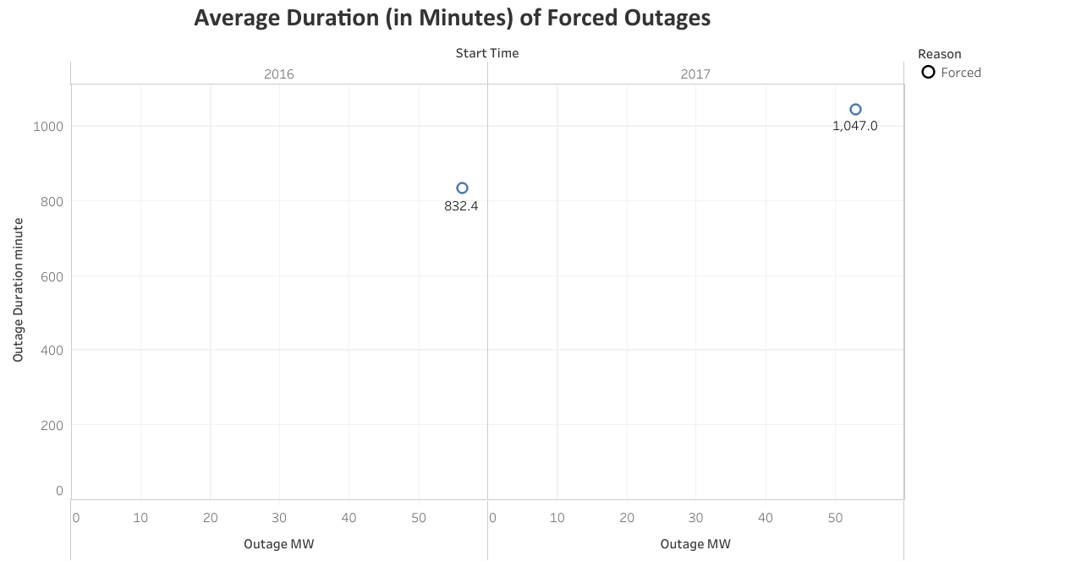
The average duration of a forced outage in 2016 was 832.4 minutes or 0.58 days. In 2017, the average duration was 1,047.0 minutes or 0.73 days. This is an increase of 20% from 2016 to 2017.

Slide 7
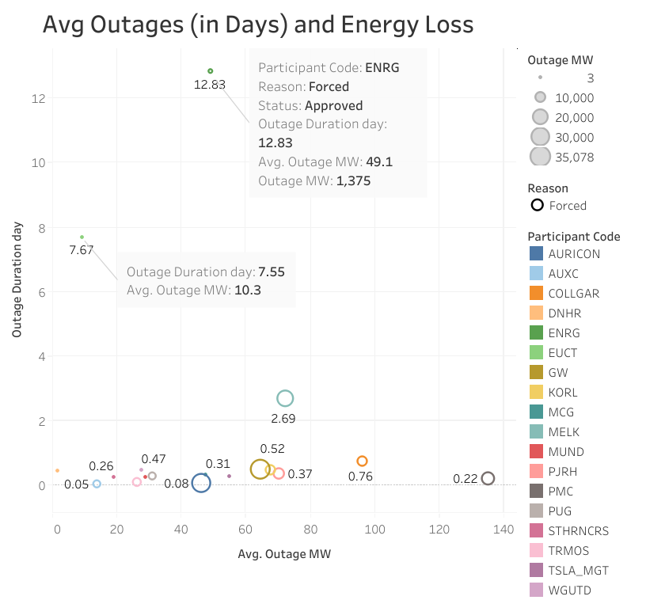
The most unreliable energy providers in terms of total energy loss are ENRG and EUCT. ENRG has an average outage duration of almost 13 days with a 49.1 MW loss of energy per day. EUCT has an average of 8 days of outages with an average energy loss of 10.3 MW.

Slide 8
Summary
Forced outages have increased by 30% from 2016 to 2017
The number of outages for Auricon has increased by 93% from 2016 to 2017 causing unreliability.
ENRG has the most energy loss averaging 49.1 mw per day over 13 days of outages.

